Slide 1

LEADING

Slide 2
LEARNING OUTCOMES
Define concept leading
Explain Leader and leadership styles
Explain motivation theories and model
Describe Communication in management
Explain conflict management
2

Slide 3
CONTENTS
  Leading and leading functions
  Leader and leadership styles
  Motivation
  Communication in management
  Conflict management

Slide 4

7.1 LEADING AND LEADING FUNCTIONS

Slide 5


Leading
Leading - Management function that involves working with and through people to accomplish organizational goals
5

Slide 6
Leading
Leading relates to:
The process of influencing a group to achieve goals
Leadership
The process by which a person’s efforts are energized, directed, and sustained toward attaining a goal.
Motivation
Leading
Communication
The transfer and understanding of meaning
Resolve the conflicts that arise within the organization
Conflict management
6

Slide 7


Why Leading is important?
7

Slide 8


FYI.....
A Gallup study finds out that about 50% of the 7,200 adults surveyed left a job "to get away from their manager"
Source: http://fortune.com/2015/04/02/quit-reasons/ - Benjamin

Slide 9

7.2 LEADER AND LEADERSHIP STYLES

Slide 10
Leader and leadership
Leader – someone who can influence others and who has managerial authority.
Leadership – what leaders do; the process of influencing a group to achieve goals.
Ideally, all managers should be leaders.
10

Slide 11
Management vs. Leadership
Characteristic activities | Management | Leadership
1. How company manage complexity? | Planning and Budgeting | Setting a direction
2.How company develop the capacity to achieve its plan? | Organizing and staffing | Aligning people
3. How company ensure plan accomplishment? | Controlling and problem solving | Motivating and inspiring
4. Coping with | Complexity | Change
Source: Kotter (2001): What leaders really do

Slide 12
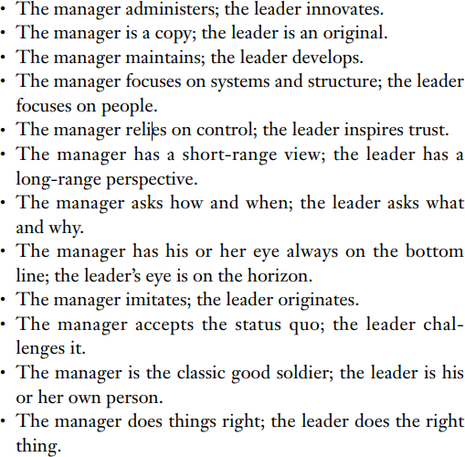
Management vs. Leadership
On Become a leader – Warren Bennis (2009)

Slide 13
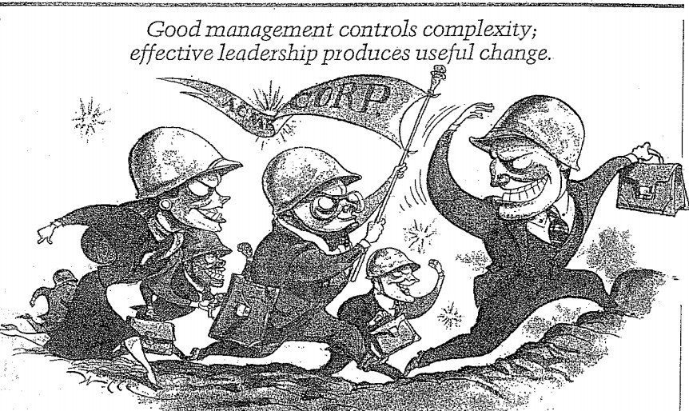
Management vs. Leadership
Leadership complements management

Slide 14
Leadership theories
Leadership Theories
Early leadership theories
-Trait theories
-Behavioral theories
+ University of Iowa studies
+ The Ohio state studies
+ University of Michigan studies
+ The managerial Grid
Contingency theories
The Fiedler Model
Hersey and Blanchard’s Situational
Leadership theory
Path-goal theory
14

Slide 15
Leadership theories
Leadership Theories
Contemporary leadership theories
Leader-Member Exchange (LMX) Theory
Transformational and Transactional Leaders
Visionary and Charismatic Leaders
➔ Attempt to determine how effective leaders interact with, inspire, and support followers
15

Slide 16
Trait theories
Trait theories - (1920s -1930s)
Research focused on identifying personal characteristics that differentiated leaders from non-leaders was unsuccessful.
It proved impossible to identify a set of traits that would always differentiate a leader (the person) from a nonleader.
16

Slide 17
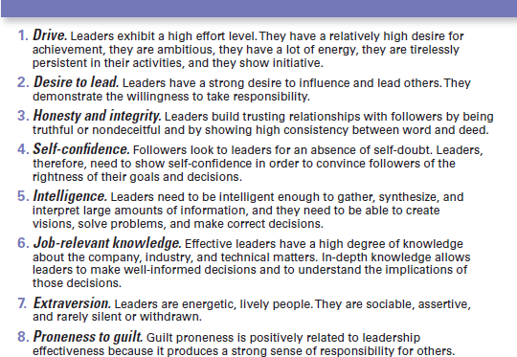
Trait theories – 8 traits associated with Leadership
17

Slide 18
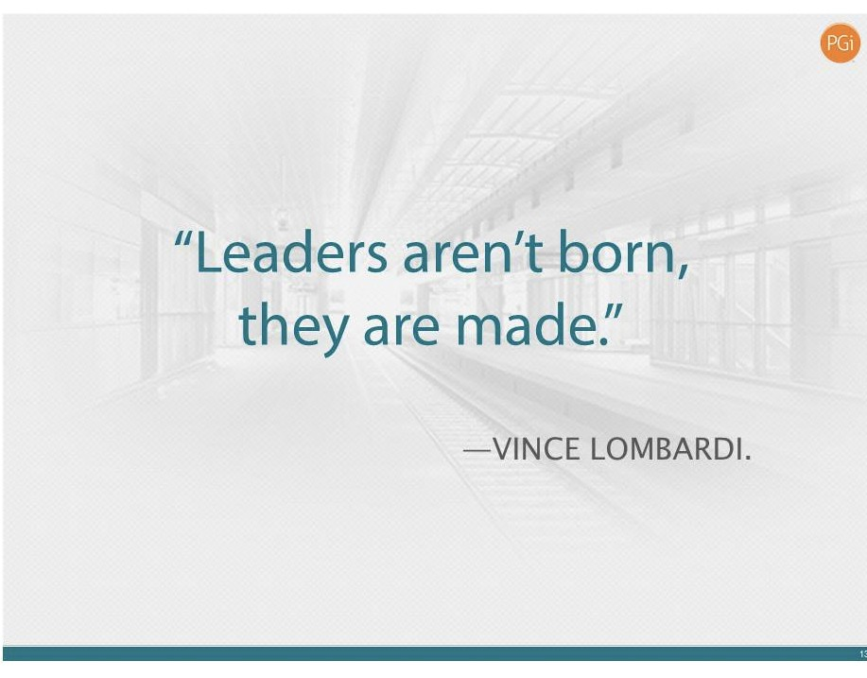
Behavioral theories
Behavioral theories– leadership theories that identify behaviors that differentiated effective leaders from ineffective leaders.
– These theories focused on how the leader interacted with his/her group members
1940s – mid 1960s

Slide 19
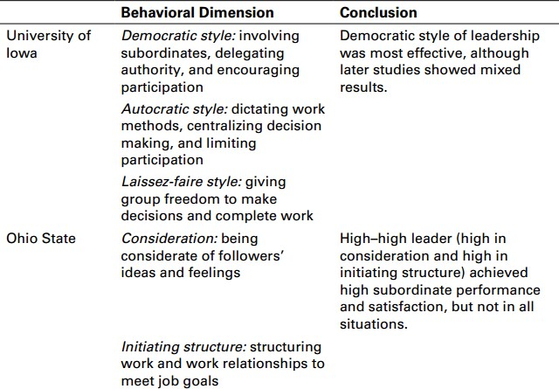
Behavioral theories

Slide 20
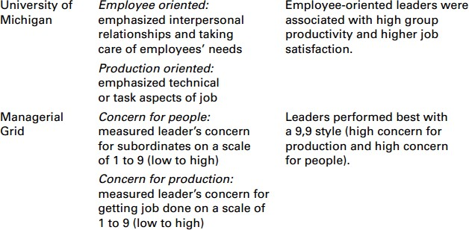
Behavioral theories

Slide 21
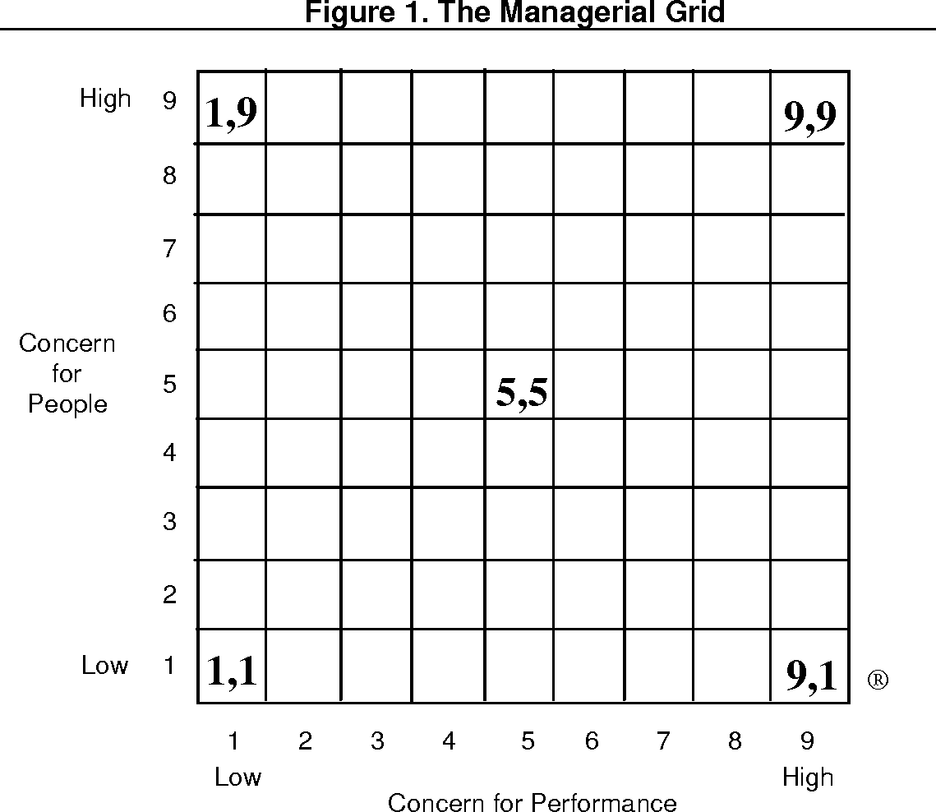
Behavioral theories- Managerial Grid

Slide 22
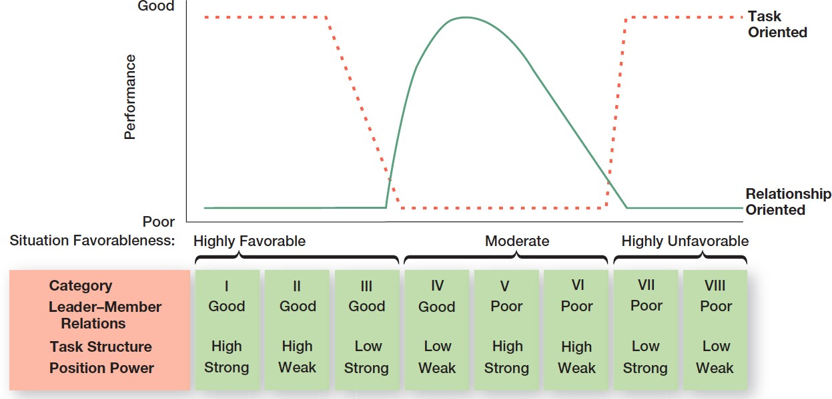
Contingency theories – Fiedler model

Slide 23
Contingency theories – Fiedler model
Leader-member relations – the degree of confidence, trust, and respect employees had for their leader; rated as either good or poor.
Task structure – the degree to which job assignments were formalized and structured; rated as either high or low.
Position power – the degree of influence a leader had over activities such as hiring, firing, discipline, promotions, and salary increases; rated as either strong or weak.

Slide 24
Contingency theories – Hersey and Blanchard’s situational leadership theory (SLT)
Also called: Situational Leadership Theory (SLT) – a leadership contingency theory that focuses on followers’ readiness.
Readiness – the extent to which followers have the ability and willingness to accomplish a specific task.

Slide 25
Contingency theories – Hersey and Blanchard’s situational leadership theory (SLT)
4 SLT Leadership Styles:
Telling (high task–low relationship): The leader defines roles and tells people what, how, when, and where to do various tasks.
Selling (high task–high relationship): The leader provides both directive and supportive behavior.
Participating (low task–high relationship): The leader and followers share in decision-making; the main role of the leader is facilitating and communicating.
Delegating (low task–low relationship): The leader provides little direction or support.

Slide 26
Contingency theories – Path-goal model
Path-goal theory – a leadership theory that says the leader’s job is to assist followers in attaining their goals and to provide direction or support needed to ensure that their goals are compatible with the goals of the group or organization.
The theory identified 4 leadership behaviors:
  Directive leader
  Supportive leader
  Participative leader
  Achievement-oriented leader

Slide 27
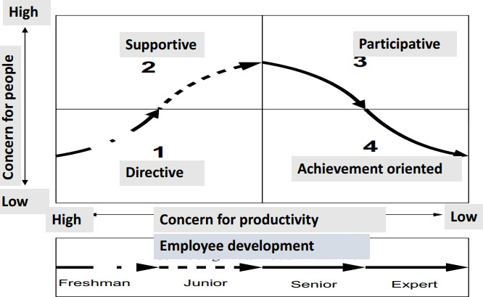
Contingency theories – Path-goal model
Path-goal theory

Slide 28
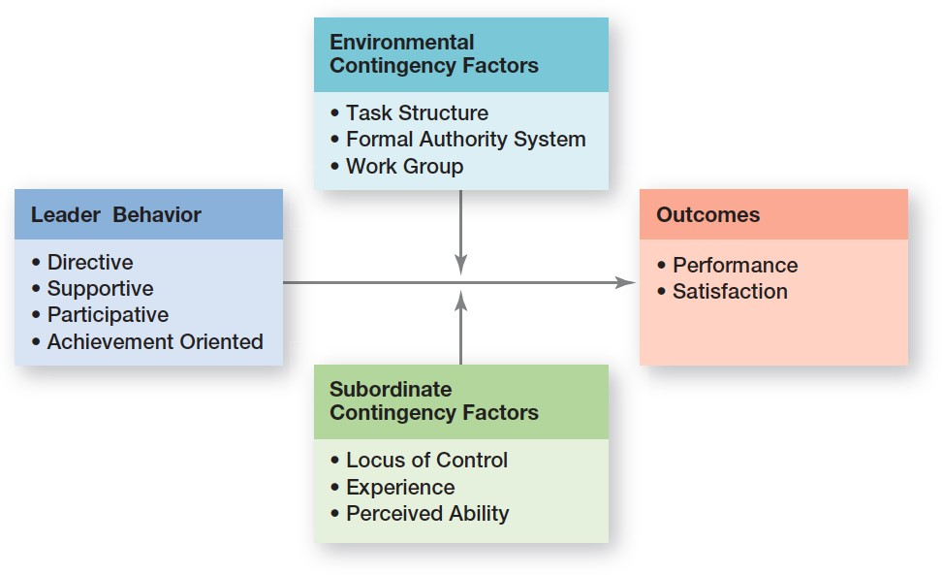
Contingency theories – Path-goal model

Slide 29
Contemporary views
Leader-member exchange theory (LMX) – the leadership theory that says leaders create in-groups and out-groups and those in the in-group will have higher performance ratings, less turnover, and greater job satisfaction.

Slide 30
Contemporary views
Transactional leaders – leaders who lead primarily by using social exchanges (or transactions).
Transformational leaders – leaders who stimulate and inspire (transform) followers to achieve extraordinary outcomes.

Slide 31
Contemporary views
Charismatic leader – an enthusiastic, self- confident leader whose personality and actions influence people to behave in certain ways.
Visionary leadership – the ability to create and articulate a realistic, credible, and attractive vision of the future that improves upon the present situation.

Slide 32
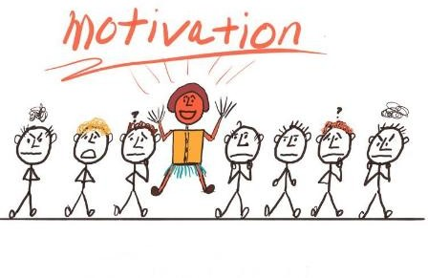
7.3 MOTIVATION

Slide 33
What is motivation
Motivation – the process by which a person’s efforts are energized, directed, and sustained toward attaining a goal.
Energy is a measure of intensity, drive, and vigor
Effort is channeled in a direction that benefits the organization

Slide 34




The role of motivation
Why employees need to be motivated?

Slide 35
Motivation theories
Motivation Theories
Early motivation theories
Maslow’s Hierarchy of Needs theory
McGregor’s theory X and theory Y
Herzberg’s Two-factor theory
Three-needs theory
Contemporary theories
Goal-setting theory
Reinforcement theory
Equity theory
Expectation theory
35

Slide 36
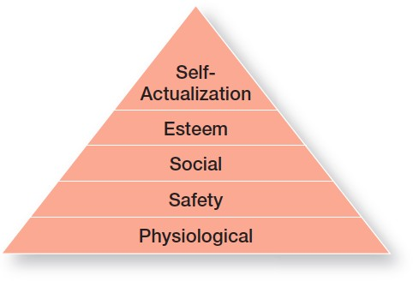
Maslow’s Hierarchy of Needs theory
Source: Maslow, Frager and Fadiman (1987)

Slide 37
McGregor’s theory X and theory Y
Theory X – the assumption that employees dislike work, are lazy, avoid responsibility, and must be coerced to perform.
Theory Y – the assumption that employees are creative, enjoy work, seek responsibility, and can exercise self-direction.

Slide 38
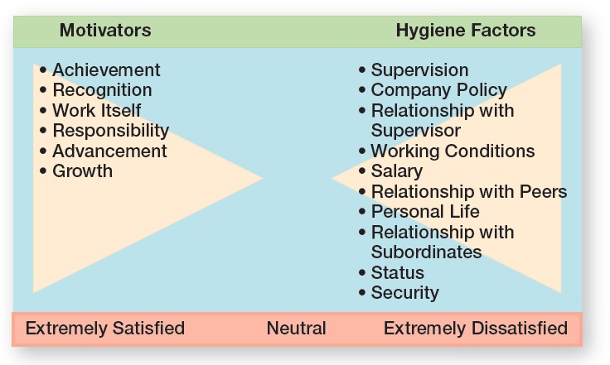
Herzberg’s Two-factor theory
Hygiene factors – factors that eliminate job dissatisfaction, but don’t motivate.
Motivators – factors that increase job satisfaction and motivation.

Slide 39
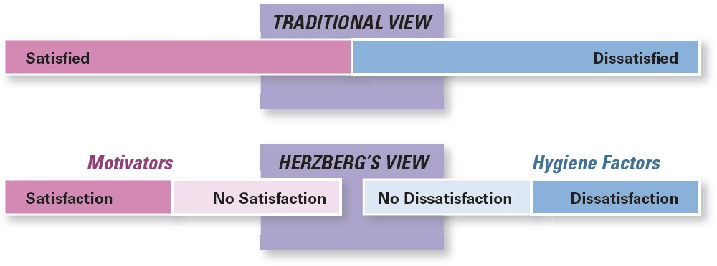
Herzberg’s Two-factor theory
Contrasting views of satisfaction-dissatisfaction

Slide 40
Three-needs theory
Three-needs theory – the motivation theory that sites three acquired (non-innate) needs (achievement, power, and affiliation) as major motives in work.
Need for achievement (nAch) – the drive to succeed and excel in relation to a set of standards.
Need for power (nPow) – the need to make others behave in a way that they would not have behaved otherwise.
Need for affiliation (nAff) – the desire for friendly and close interpersonal relationships.

Slide 41
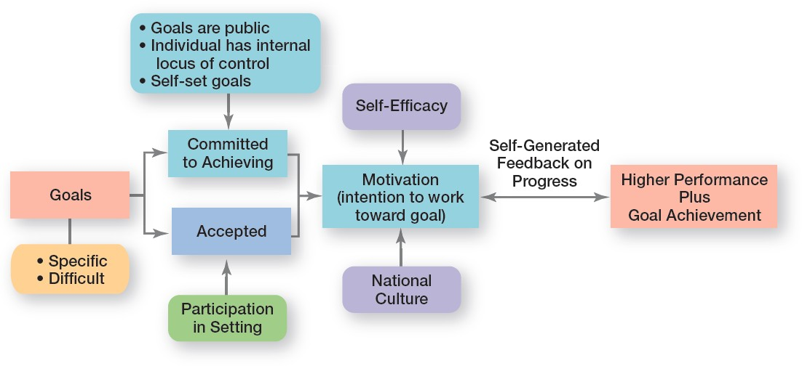
Goal-setting theory
Goal-setting theory – the proposition that specific goals increase performance and that difficult goals, when accepted, result in higher performance than do easy goals.

Slide 42
Reinforcement theory
Reinforcement theory - the theory that behavior is a function of its consequences
Reinforcers – consequences immediately following a behavior which increase the probability that the behavior will be repeated.
➔ This theory ignores factors such as goals, expectation, and needs and focuses solely on what happens to a person when he/she do something

Slide 43
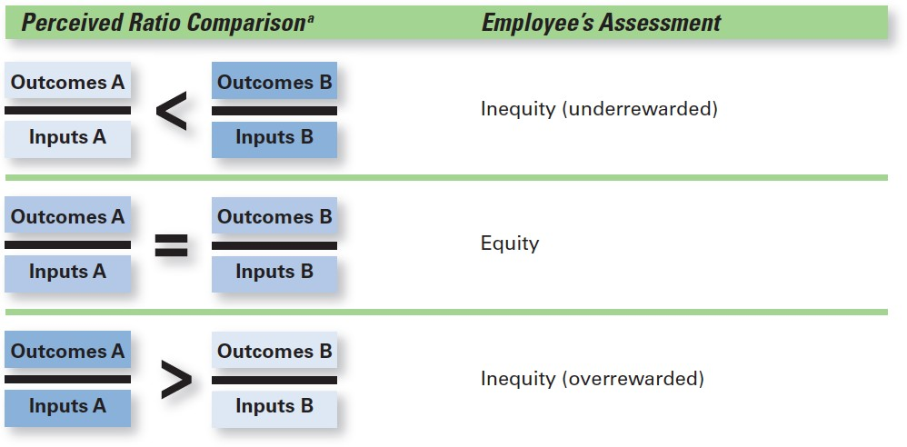
Equity theory
Equity theory – the theory that an employee compares his or her job’s input-outcome ratio with that of relevant others and then corrects any inequity

Slide 44
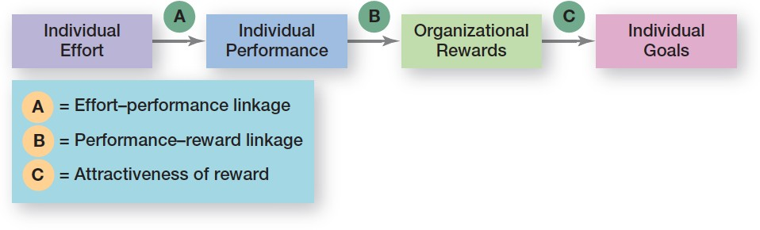
Expectancy theory
Expectancy theory – the theory that an individual tends to act in a certain way based on the expectation that the act will be followed by a given outcome and on the attractiveness of that outcome to the individual.

Slide 45
Following are 12 job factors that contribute to job satisfaction
An interesting job I enjoy doing
A boss who treats everyone the same regardless of the circumstances
Getting praise and other recognition and appreciation for the work that I do
A job that is routine without much change from day to day
The opportunity for advancement
A nice job title regardless of pay
Job responsibility that gives me freedom to do things my way
Working conditions (safe environment, cafeteria, etc.)
The opportunity to learn new things
An emphasis on following company rules, regulations, procedures, and policies
A job I can do well and succeed at
Job security for life

Slide 46
Group:
Classify these factors into motivators and Hygiene factors
Motivators | Hygiene factors

Slide 47
Individual:
Rate each according to how important it is to you by placing a number from:
5. Very Important
4. Important
3. Somewhat Important
2. Slightly Important
1. Not Important

Slide 48
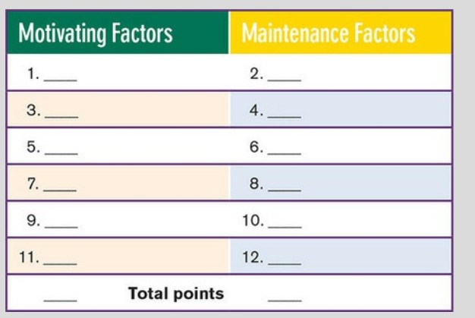

Slide 49

7.4 COMMUNICATION IN MANAGEMENT

Slide 50
What is communication?
Communication – the transfer and understanding of meaning.
– If Information or ideas have not been conveyed, communication hasn’t taken place
What is the difference between information and data????

Slide 51
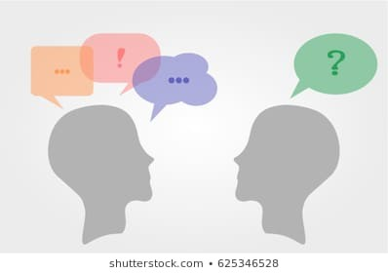

What is communication? (cont.)
Interpersonal Communication – communication between two or more people.
Organizational Communication – all the patterns, networks, and systems of communications within an organization.

Slide 52






The roles of communication?
Control: Formal and informal communications act to control individuals’ behaviors in organizations.
Motivation: Communications clarify for employees what is to be done, how well they have done it, and what can be done to improve performance.
Emotional Expression: Social interaction in the form of work group communications provides a way for employees to express themselves.
Information: Individuals and work groups need information to make decisions or to do their work.

Slide 53
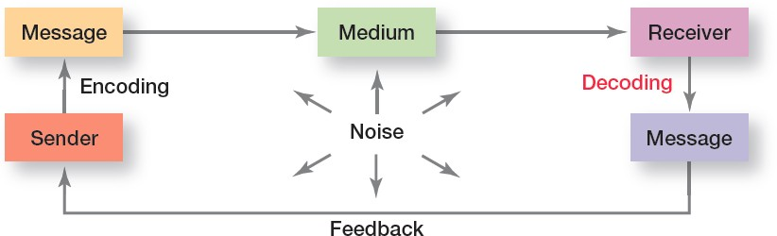
The interpersonal communication process
Communication process – the process of transferring meaning from one person to another.

Slide 54
The interpersonal communication process (cont.)
Message– a purpose to be conveyed.
Encoding – converting a message into symbols.
Medium (Channel) – the medium a message travels along.
Decoding – retranslating a sender’s message.
Noise – any disturbances that interfere with the transmission, receipt, or feedback of a message.

Slide 55
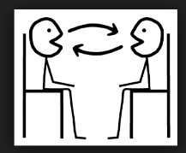
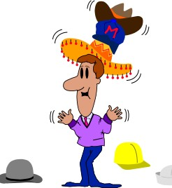

Communication methods
What are the advantages and disadvantages of each method?
Oral
Communication
Body language
Written

Slide 56
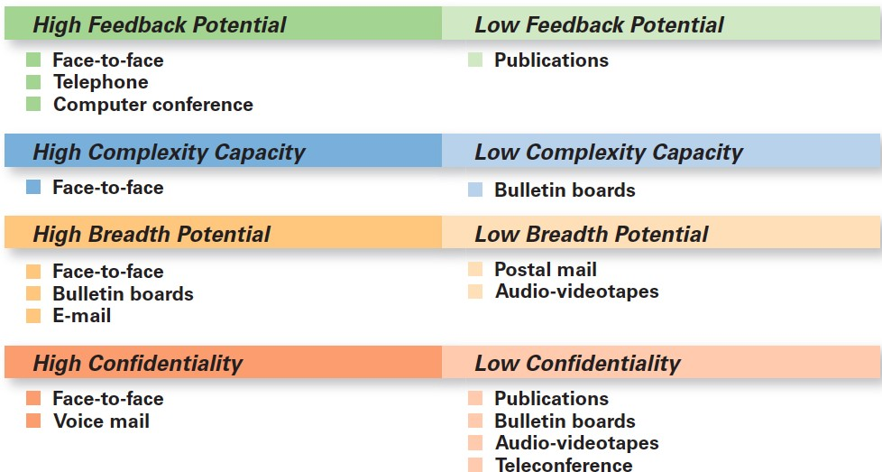
Comparison of Communication methods

Slide 57
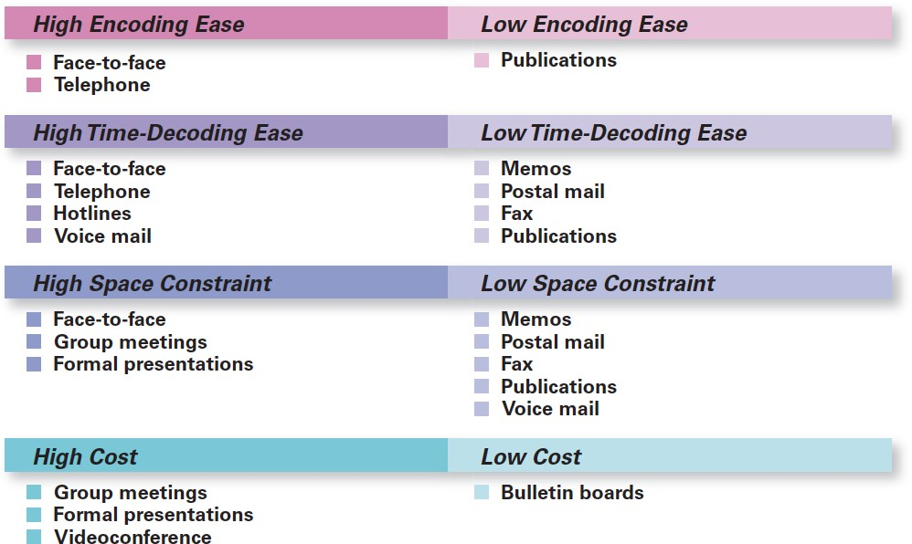
Comparison of Communication methods (cont.)

Slide 58
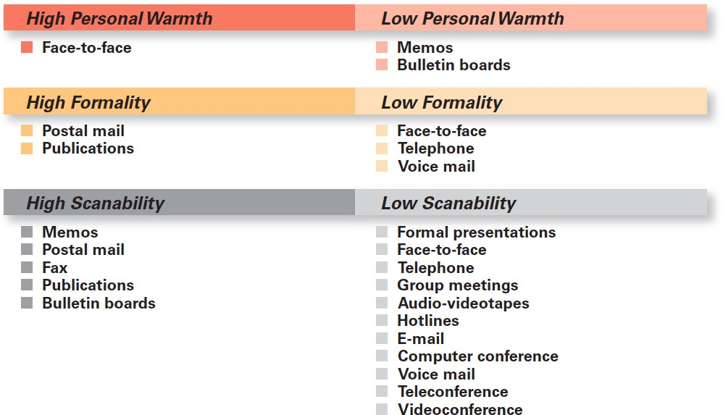
Comparison of Communication methods (cont.)

Slide 59
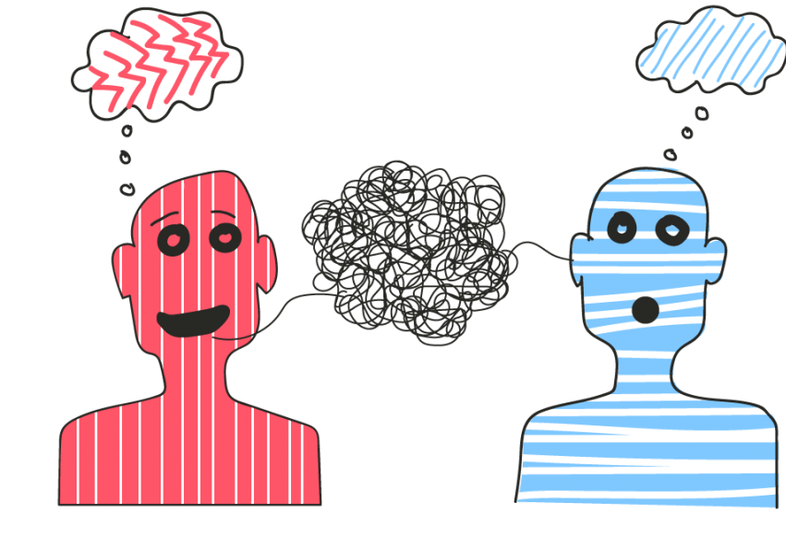
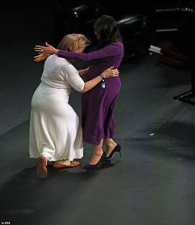
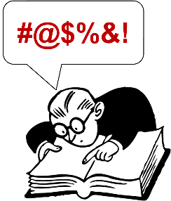
Barriers to communication
Cognitive barriers: Information overload Filtering
Emotional barriers
Sociocultural barriers (jargon)
National culture

Slide 60
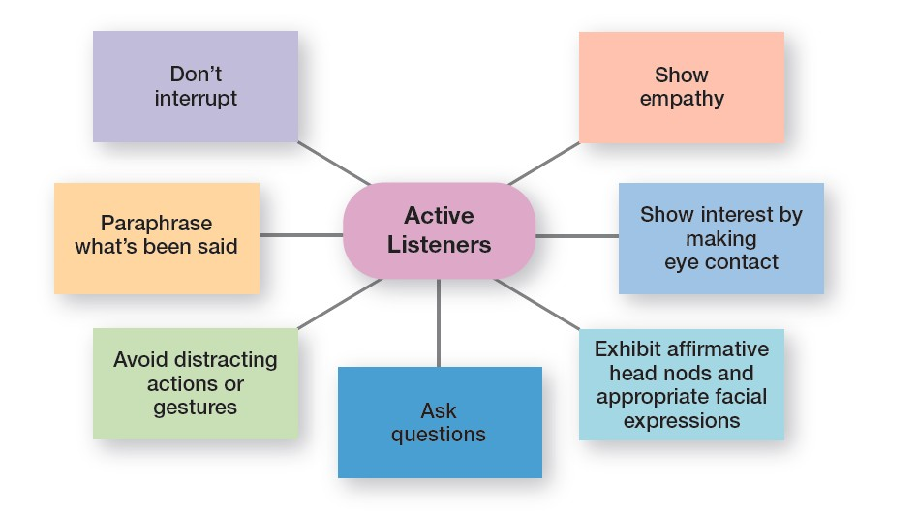
Overcoming communication barriers
Use feedback
Simplify language
Listen actively
Constrain emotions
Watch nonverbal cues

Slide 61
Organizational communication
Formal communication – communication that takes place within prescribed organizational work arrangements.
Informal communication – communication that is not defined by the organization’s structural hierarchy.

Slide 62
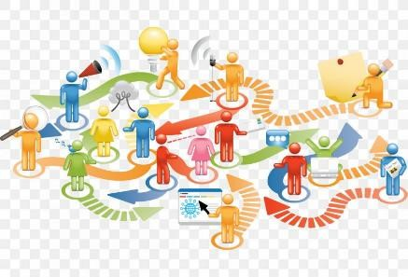
Organizational communication networks
Communication Networks – the variety of patterns of vertical and horizontal flows of organizational communication.
Grapevine – the informal organizational communication network.

Slide 63
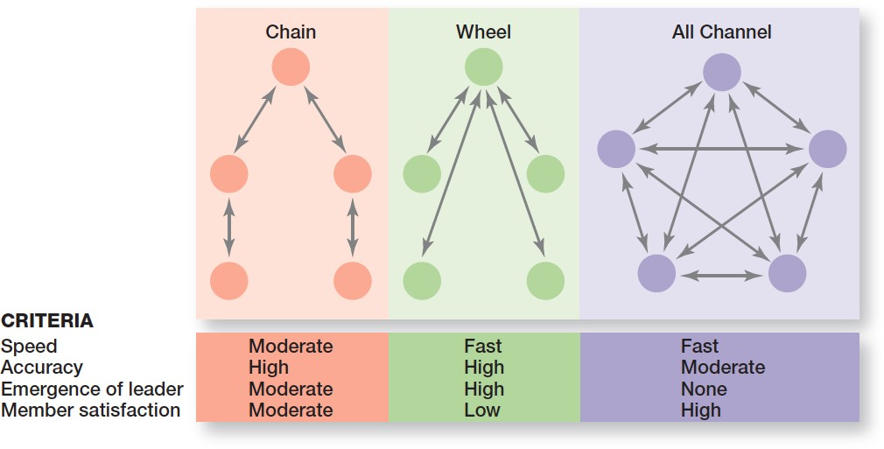
Organizational communication networks (cont.)

Slide 64

Technology affects managerial communication
Networked Systems
Wireless Capabilities
Provide some issues with current managing communication in an Internet World????

Slide 65
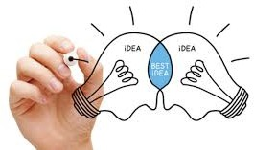
7.5 CONFLICT MANAGEMENT

Slide 66
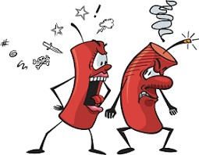

Conflict management
Conflict– perceived incompatible differences that result in interference or opposition.
Traditional view of conflict
– the view that all conflict is bad and must be avoided.
Human relations view of conflict – the view that conflict is a natural and inevitable outcome in any group.

Slide 67
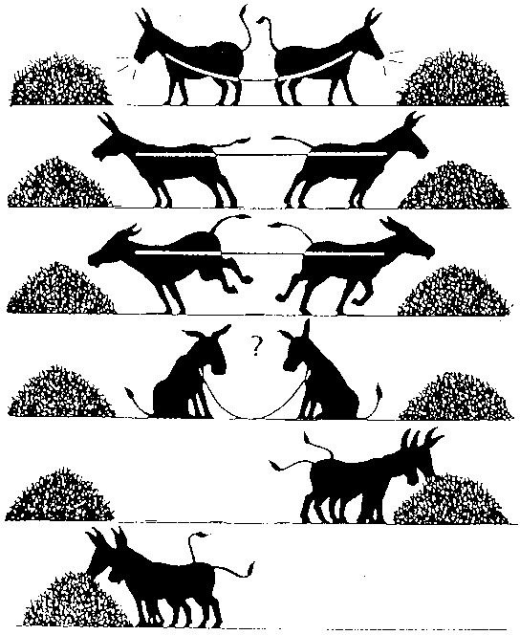
Conflict management (cont.)
Interactionist view of conflict – the view that some conflict is necessary for a group to perform effectively.
Functional conflicts – conflicts that support a group’s goals and improve its performance.
Dysfunctional conflicts – conflicts that prevent a group from achieving its goals.

Slide 68
Conflict management (cont.)
Task conflict – conflicts over content and goals of the work.
Relationship conflict – conflict based on interpersonal relationships.
Process conflict – conflict over how work gets done.

Slide 69
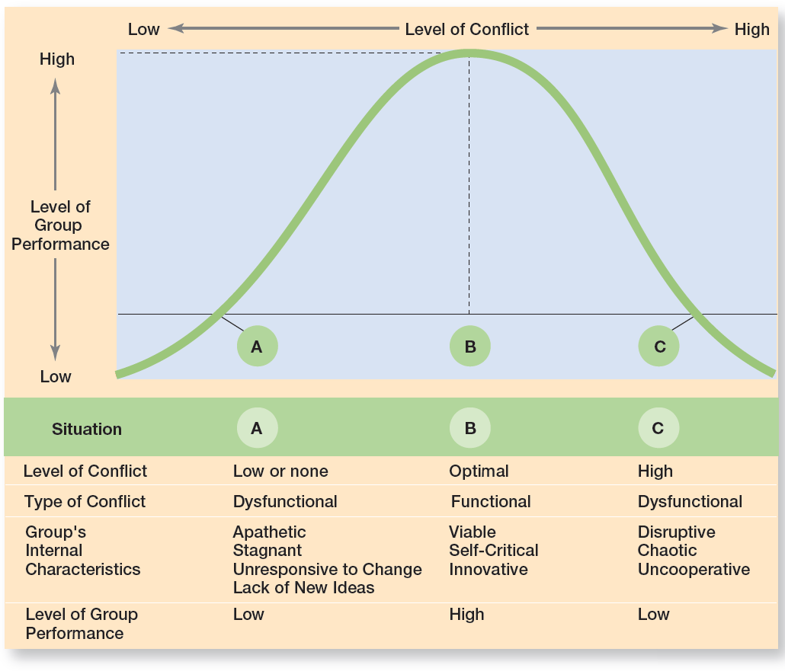
Conflict management (cont.)
Conflict and group performance

Slide 70


